Slide 1
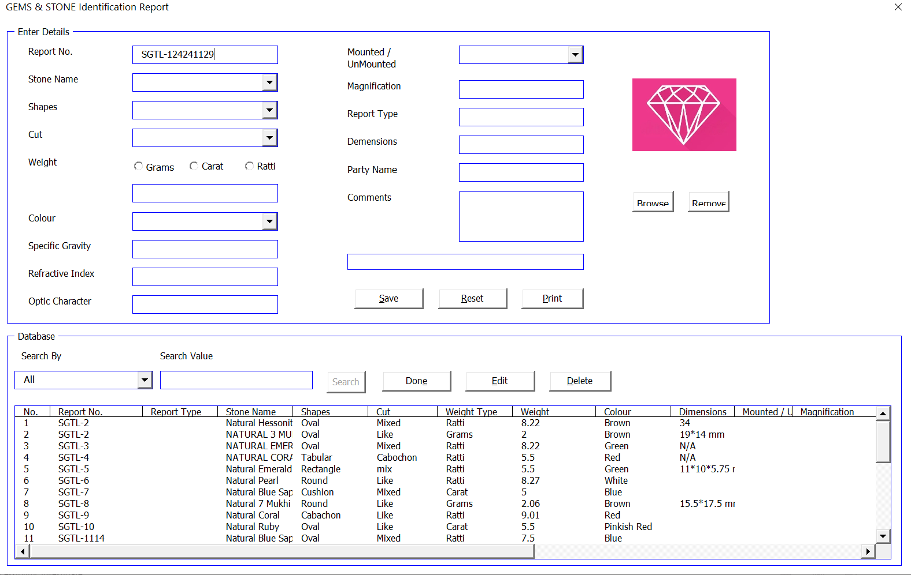
Customer User Form

Slide 2
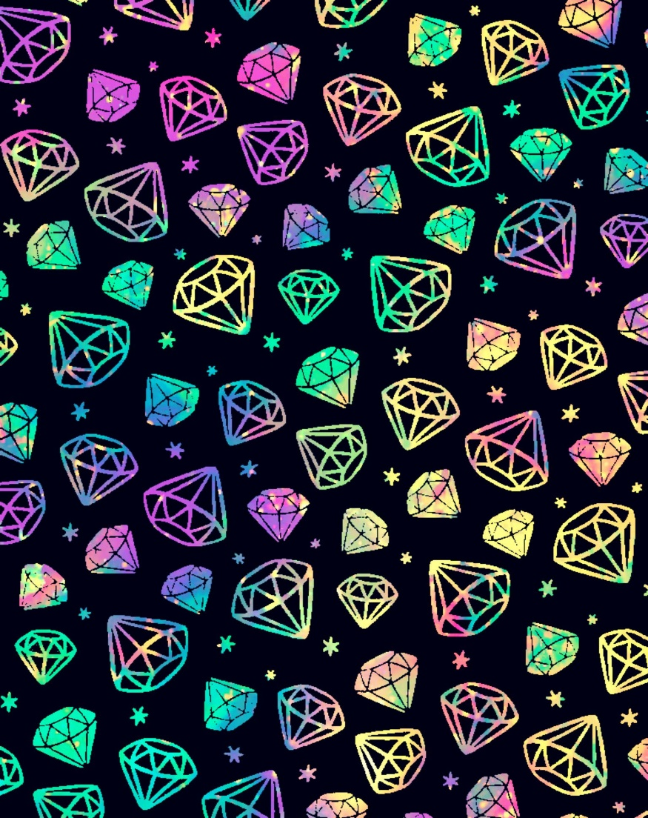
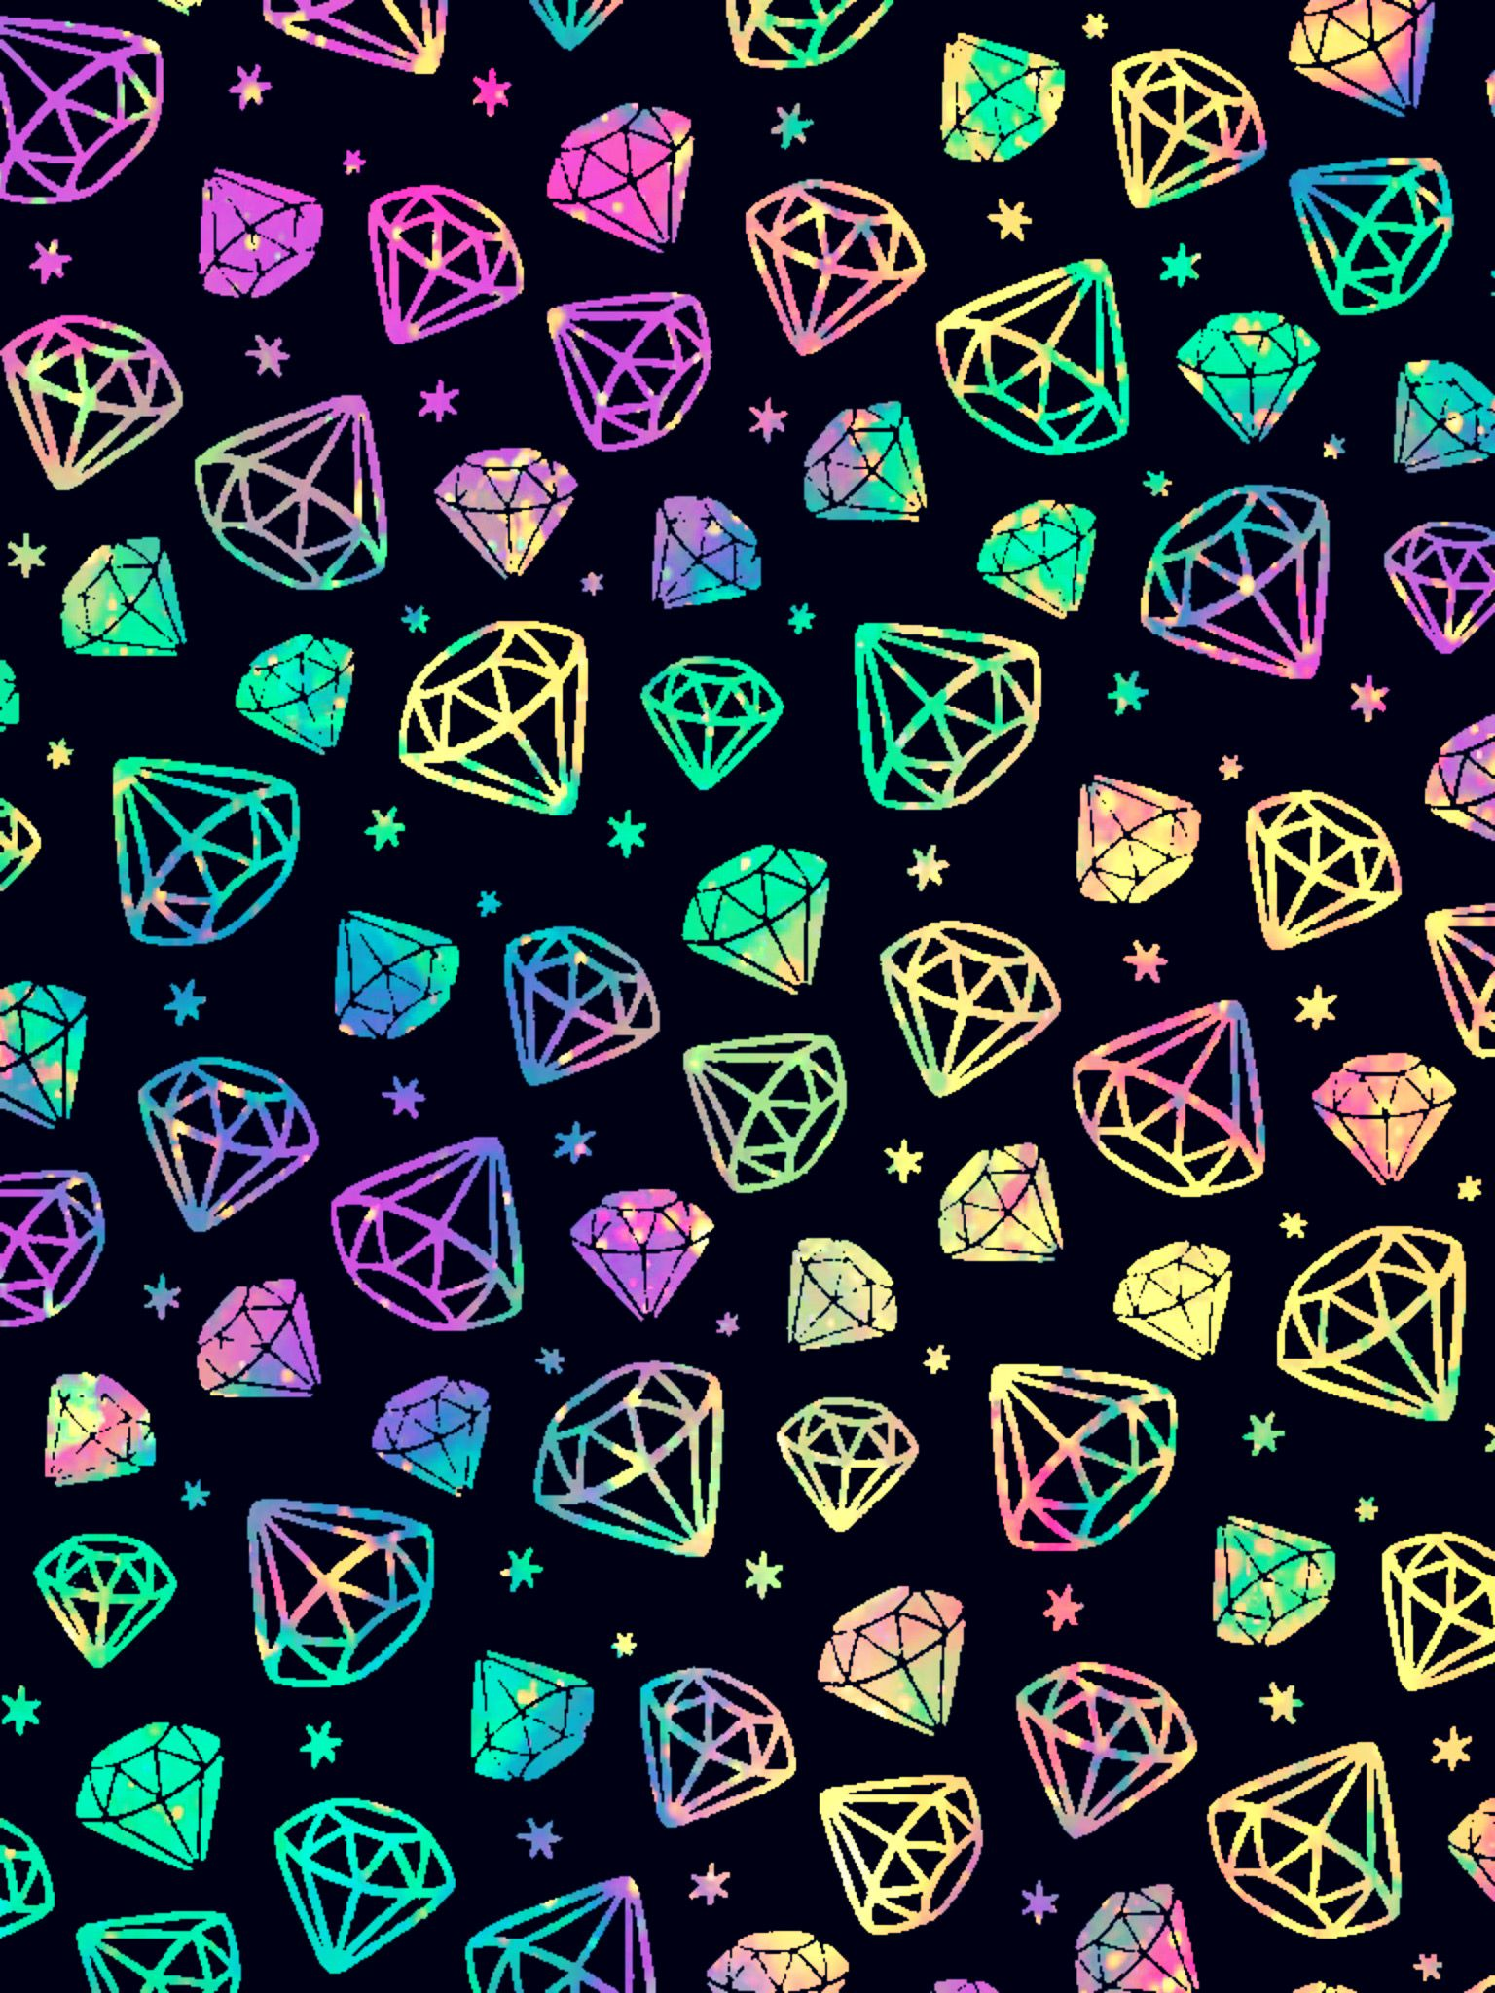
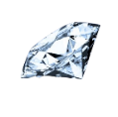
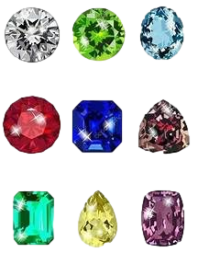
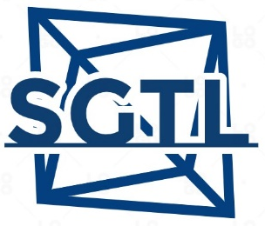
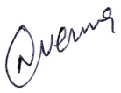


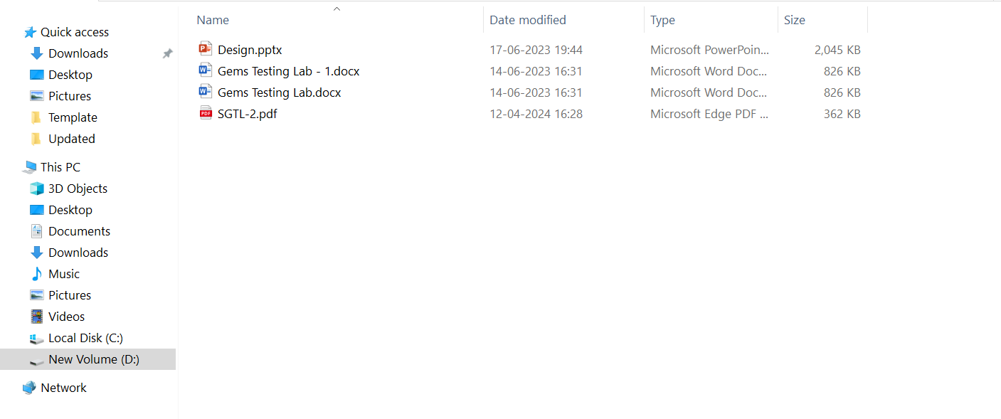
SGTL
Testing Labs
&
SGTL Uttam nagar new delhi 110059. SGTL Uttam nagar new delhi
GEMSTONE IDENTIFICATION REPORT
TERMS & CONDITIONS :
Report No.
:
SGTL-1115
﻿All SGTL Reports are printed on original paper with logo of SGTL. No corrections or alterations in any form shall be accepted for the SGTL Reports. The photographic image printed on the report may be differ from its physical appearance. The results of the report can be differ from previous report if the same gemstone is re-examined. Neither SGTL nor its any employees will be held responsible for any loss and damage happens during the examination. This report is considered to be null and void, if in any case alterations are made either to the gemstone or to the report at any time after the report has been prepared.
Customer Card Design
Shapes
&
Cut
:
Cabachon / like
Weight
:
6.21 Ratti
Colour
:
Red
Refractive Index
:
1.48-1.65
Optic Character
:
AGG
Specific Gravity
:
2.65
Natural Coral, Ruby, Sapphire Natural
Dimensions
:
16.5x5.7x6.5mm
rgdgdljgldgfldngfnksngklskndksndkdnskgnskng
Comments
:
Namit Verma, Gemologist
9090909090
abc@gmail.com
Customer Card PDF File

Slide 3
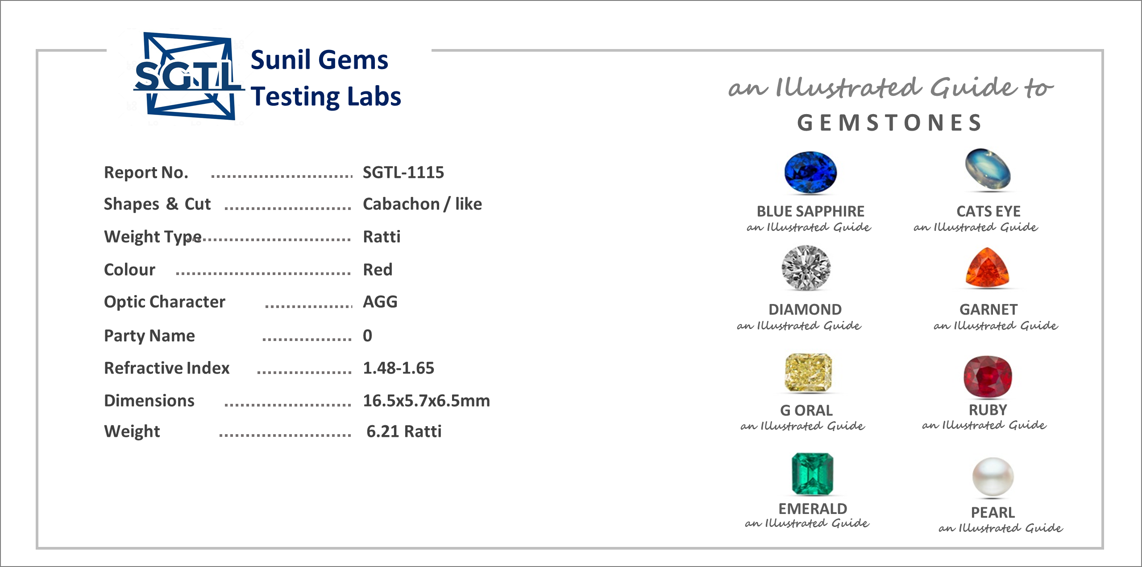
Customer Report File

Slide 4
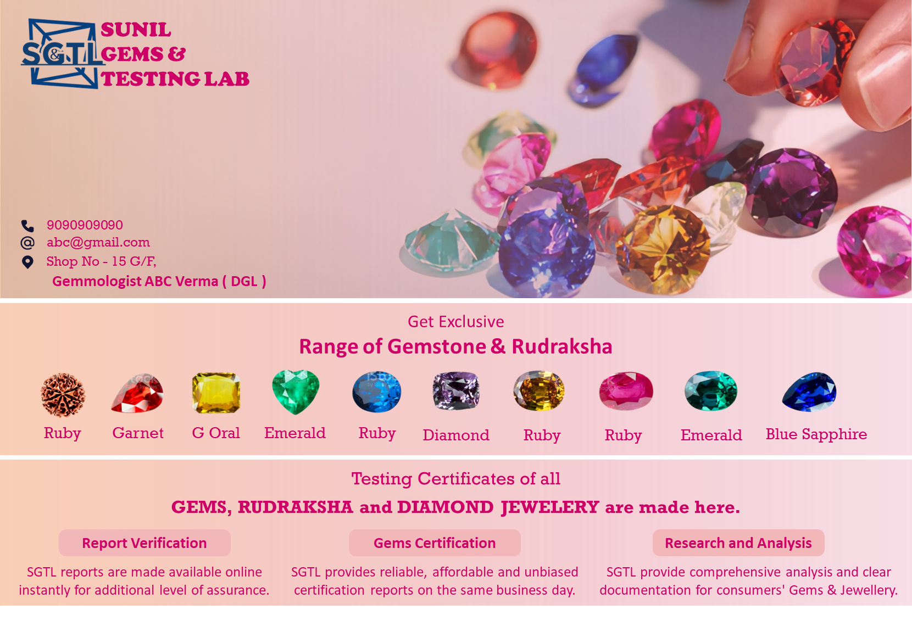
Shops Owner Page / Banner for Marketing

